Slide 1
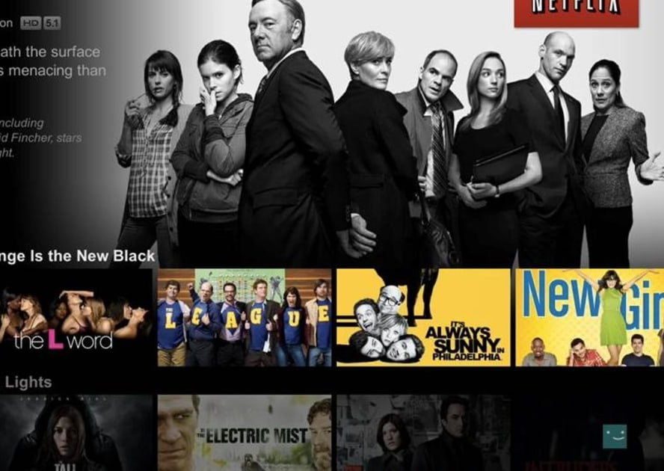
Enhancing Recommender Systems using various Matrix Factorization Techniques
Charanjit Singh
Parampreet Singh

Slide 2
CONTENTS
Recommender Systems
Collaborative Filtering
Matrix Factorization
Project Methodology
Results and Conclusion

Slide 3
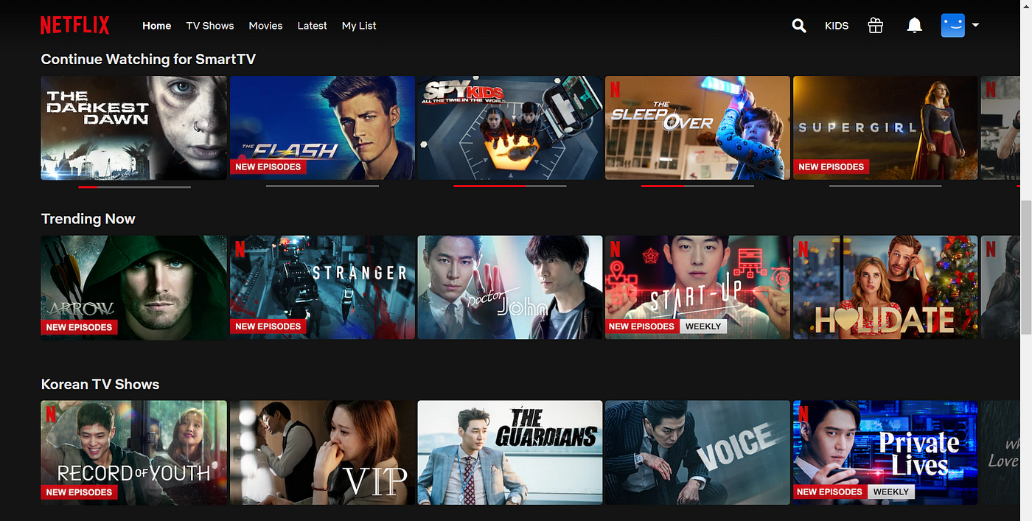

Introduction to Recommender Systems
Automated tools to predict user preferences and recommend relevant items.
Essential for personalized user experiences in shopping, entertainment, and social media.
Streamlines content discovery and enhances satisfaction by personalizing choices.
Drives engagement and sales through tailored recommendations.
Ranking
Over 80% of what people watch comes from recommendations
Recommendations are driven by Machine Learning
Rows

Slide 4
Types of Recommender Systems
Recommender Systems
Content-Based
Collaborative Filtering
Hybrid Models
Utilize item features to recommend additional similar items
f(movie) → {movies}
Make recommendations based on the preferences of similar users f(movies, user) → {movies}
Combine content-based and collaborative filtering to leverage the strengths of both
Personalization based on user preferences
transparent recommendations
Can handle complex user behaviors
No need for item metadata
More robust recommendations
Mitigates cons of both types.
Limited to known item attributes
May lead to a narrow range of suggestions
Struggles with new items (cold start problem)
May recommend popular items excessively
More complex to implement
Requires tuning to get the right balance

Slide 5
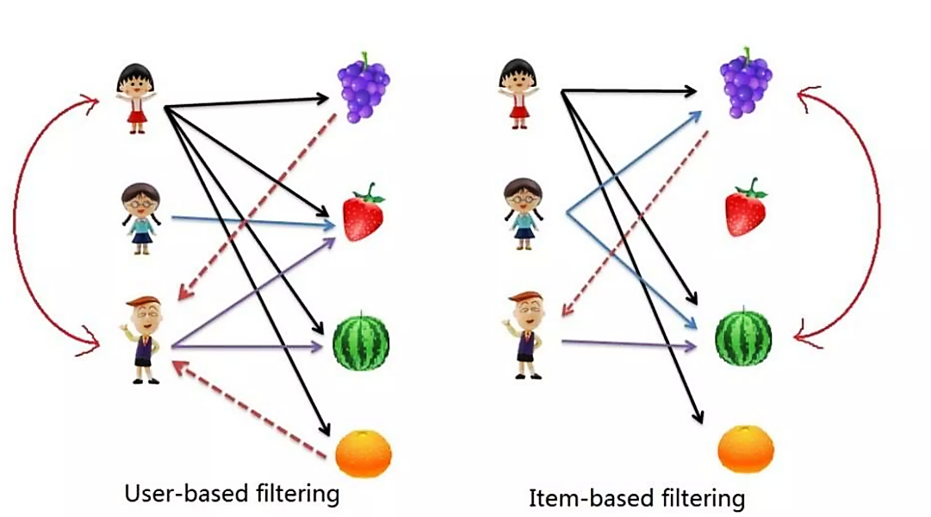
Collaborative Filtering
A method that predicts a user's preferences based on the likes and dislikes of similar users.
Enhances the relevance of recommendations as it learns from user behavior patterns.
User-Based Collaborative Filtering
Recommendations are based on the similarity between users
Intuitive and simple to implement.
Scalability issues with large datasets
Performance issues with sparse data
Item-Based Collaborative Filtering
Identifies similarity between items based on user ratings
More stable over time
Easier to scale as the items usually less than the users
Requires enough ratings
Less effective for new items with few ratings

Slide 6
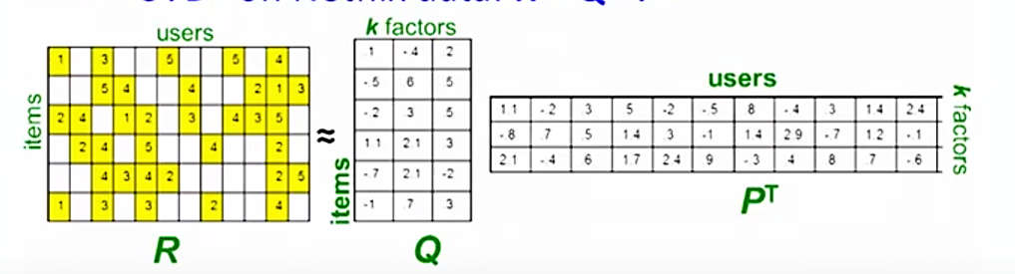
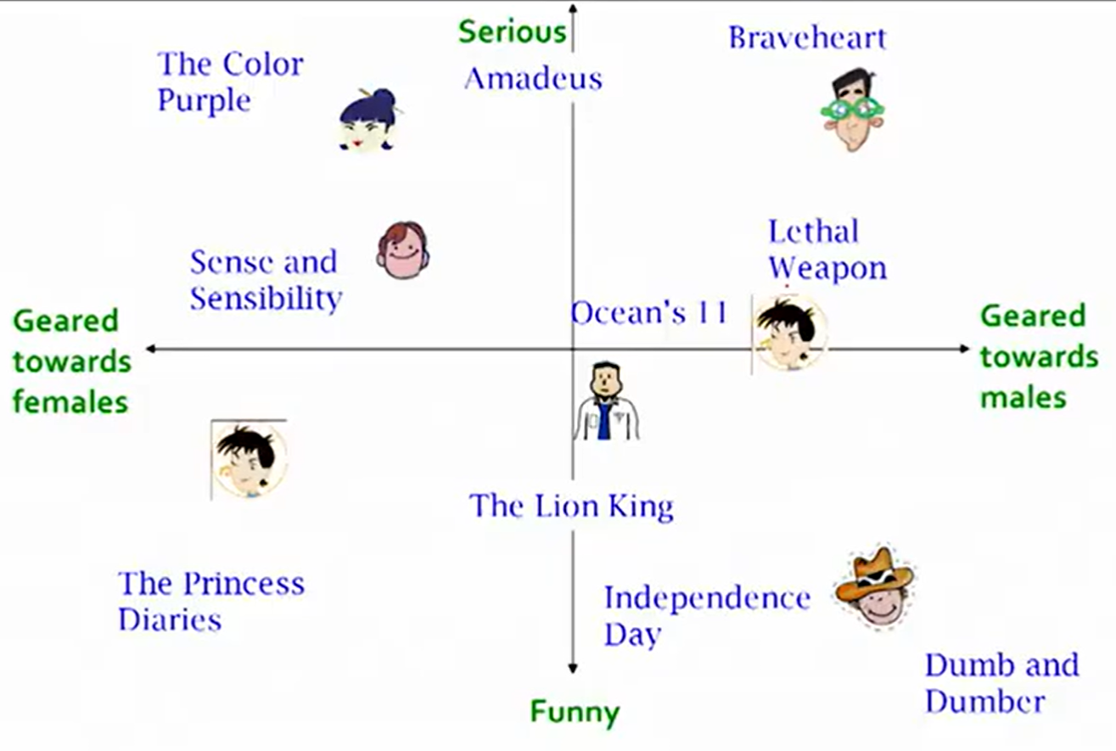
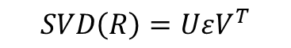
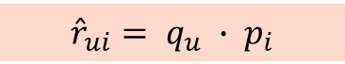
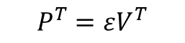

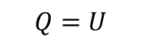
Matrix Factorization Overview
Dimensionality reduction technique to decompose the utility matrix R into lower-dimensional matrices representing latent factors
$$R ≈Q × P^{T}$$
Latent features represent underlying characteristics of items that might not be directly observable.
The model predicts unknown ratings by dot product of user and item latent features:
$${\hat{r}}_{ui}= q_{u} ∙ p_{i}$$
$$SVD\left(R\right)=UεV^{T}$$
$$Q=U$$
$$P^{T}=εV^{T}$$
Fig. Latent Factors

Slide 7
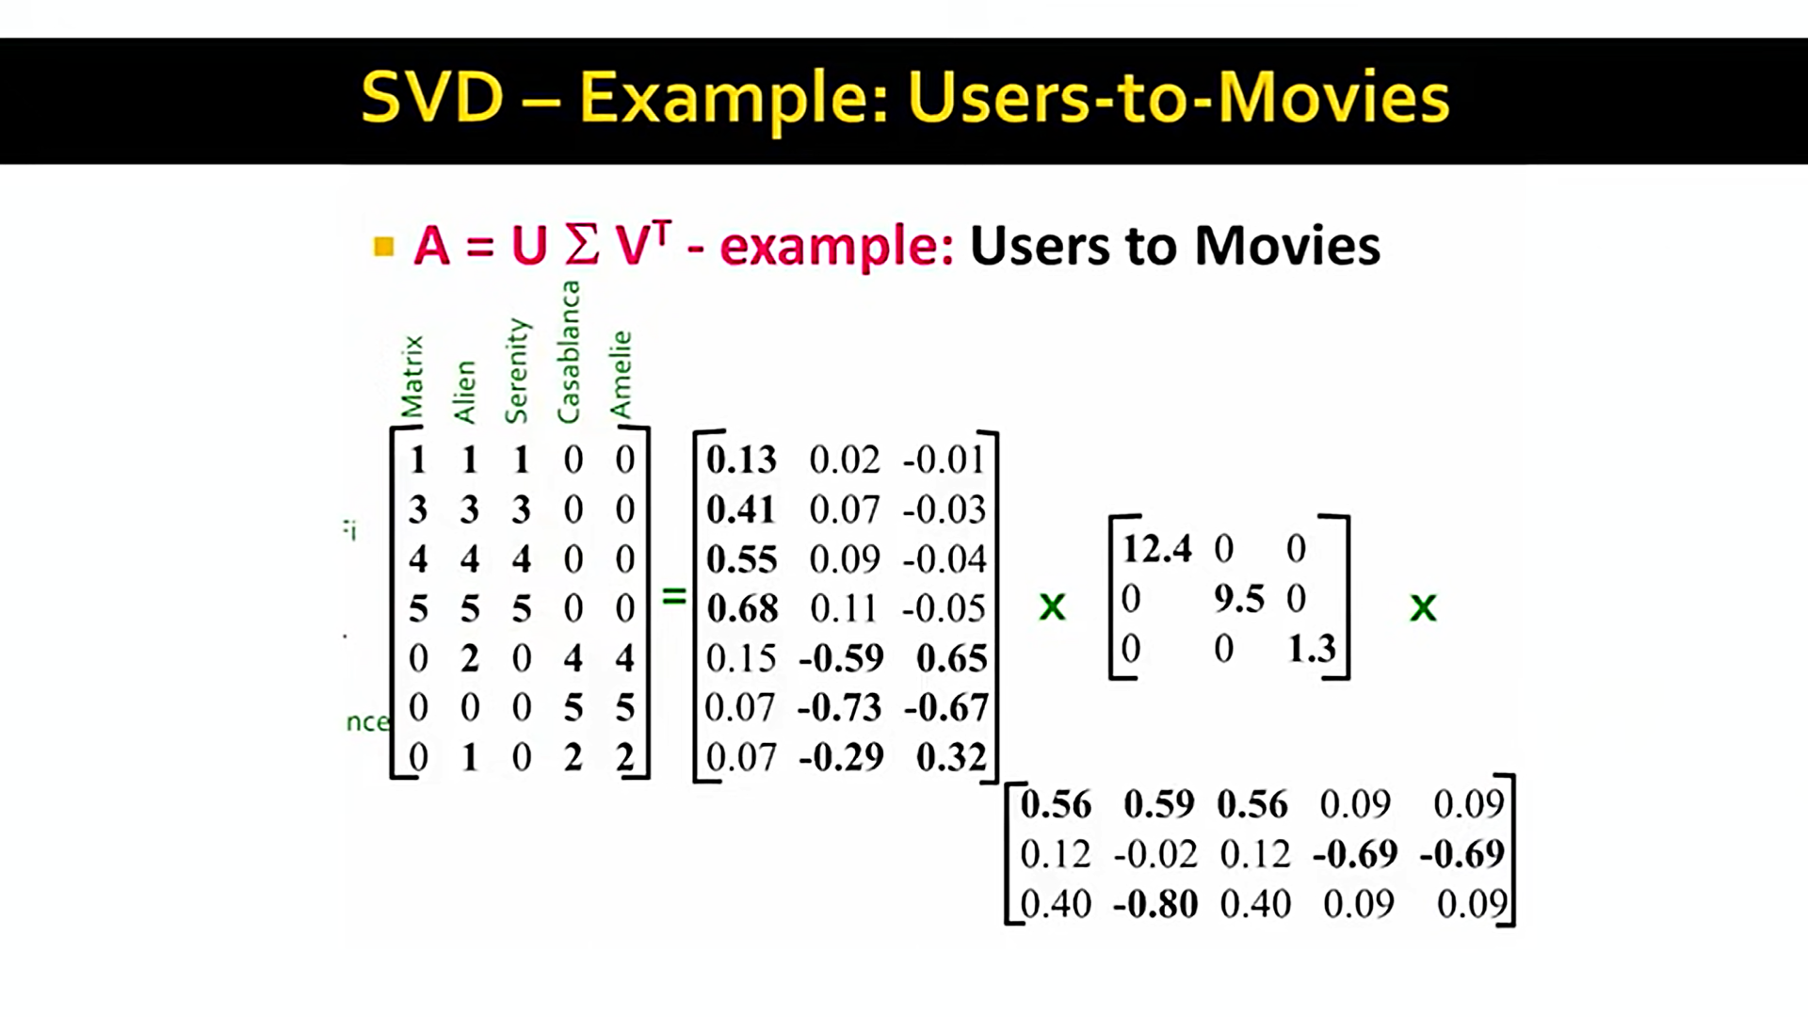
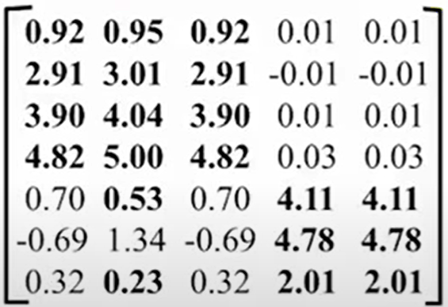

Singular Value Decomposition (SVD)
SVD is a matrix factorization technique that decomposes a matrix into three distinct component matrices.
For a given matrix A, SVD finds matrices U, Σ and $V^{T}$ such that $A=U\text{Σ}V^{T}$
Sci-Fi
Romantic
Strength of Sci-Fi concept
Strength of Romantic concept
$$≈$$
Users
Σ: Singular Values
U: User-Concept
V^{T}: Item-Concept

Slide 8
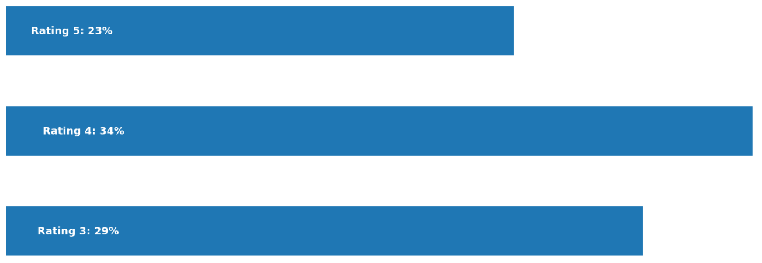
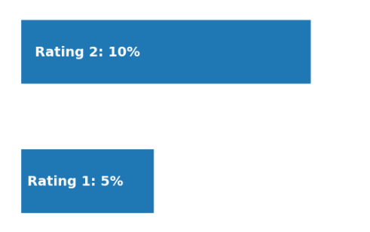
Netflix Prize Dataset
Released during the Netflix Prize competition to improve their recommendation algorithms
Includes over 100 million movie ratings, ranging from 1 to 5 stars.
Features a broad mix of over 17,000 movies.
People tend to rate movies they like
85%
15%

Slide 9
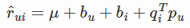
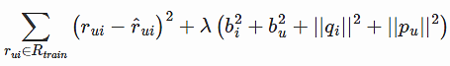
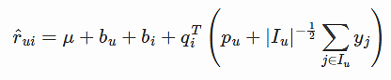
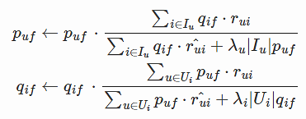
Methodology
1. SVD(): The famous SVD algorithm, as popularized by Simon Funk during the Netflix Prize Competition
Prediction →
Objective Function →
2. SVD++(): An extension of SVD considering implicit ratings
Prediction →
Objective Function →
3. Non – Negative MF(): An extension of SVD where user and item factors are kept positive.
Prediction →
Objective Function →

Slide 10
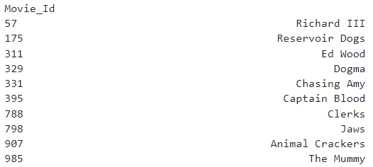
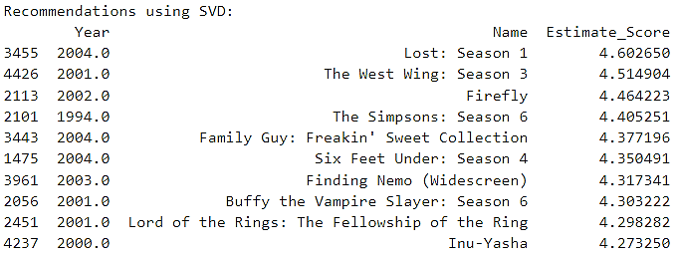
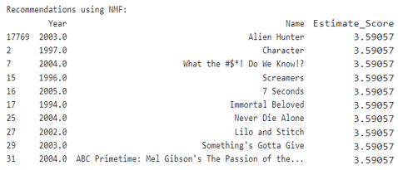
Results and Discussion
Algorithm | Evaluation Metric | Result
SVD | RMSE | 0.85
 | MAE | 0.66
NMF | RMSE | 0.91
 | MAE | 0.71
Movies liked by user 83510 in the past
Predictions
SVD
NMF

Slide 11
Conclusion and Future Work
Key Takeaways
Matrix factorization techniques significantly improved recommendation accuracy.
SVD and SVD++ handled explicit feedback, while NMF effectively managed implicit feedback.
We achieved an RMSE of as low as 0.85 and MAE of 0.66
Future Work
Enhancing the cold start performance for new users and items.
Incorporating more complex user behaviors and temporal dynamics into the model.
Integration of additional data sources, such as user demographics and contextual information.

Slide 12


